Slide 1
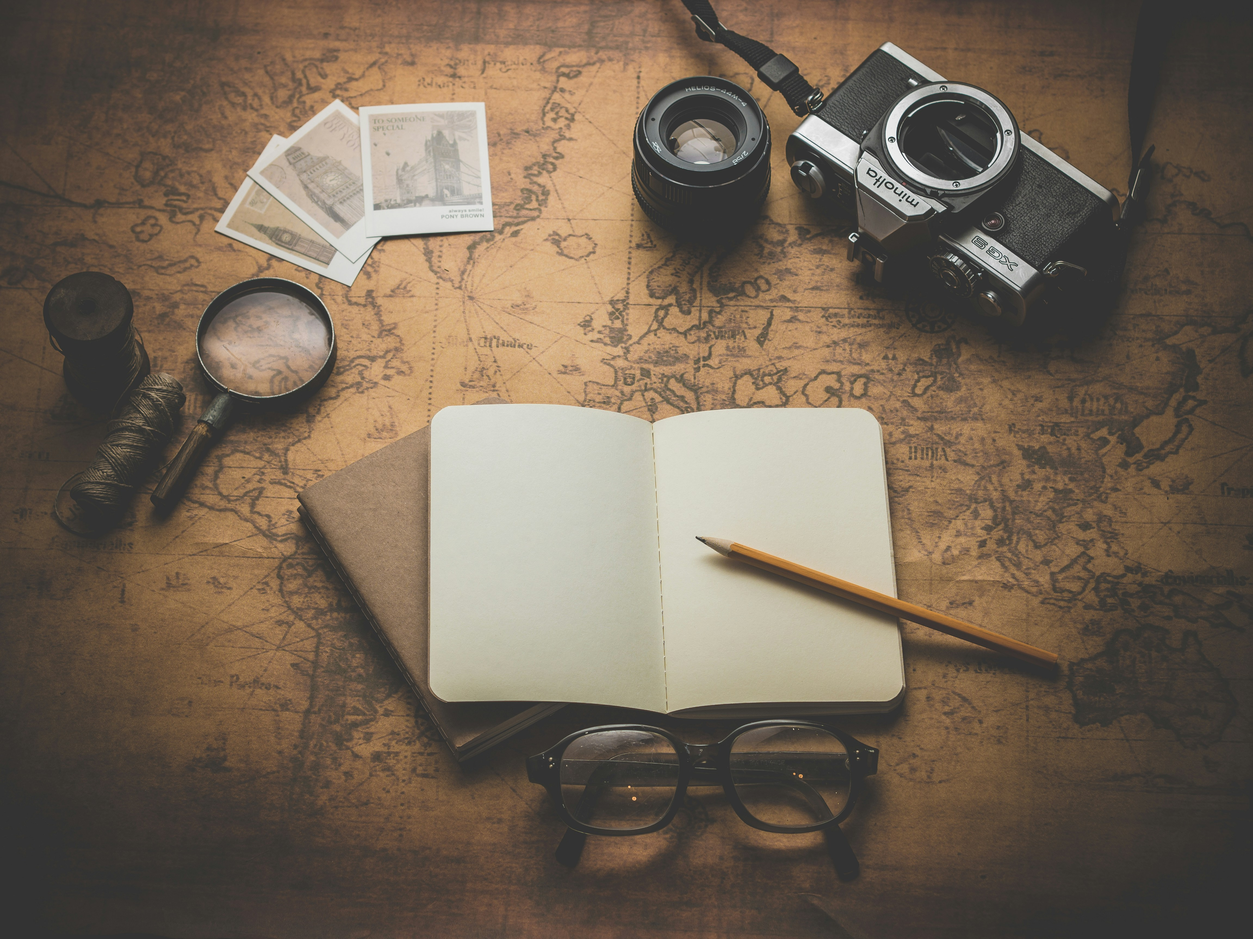
冒險故事
(Animaze)
Notes:
https://unsplash.com/photos/flat-ray-photography-of-book-pencil-camera-and-with-lens-3OiYMgDKJ6k

Slide 2
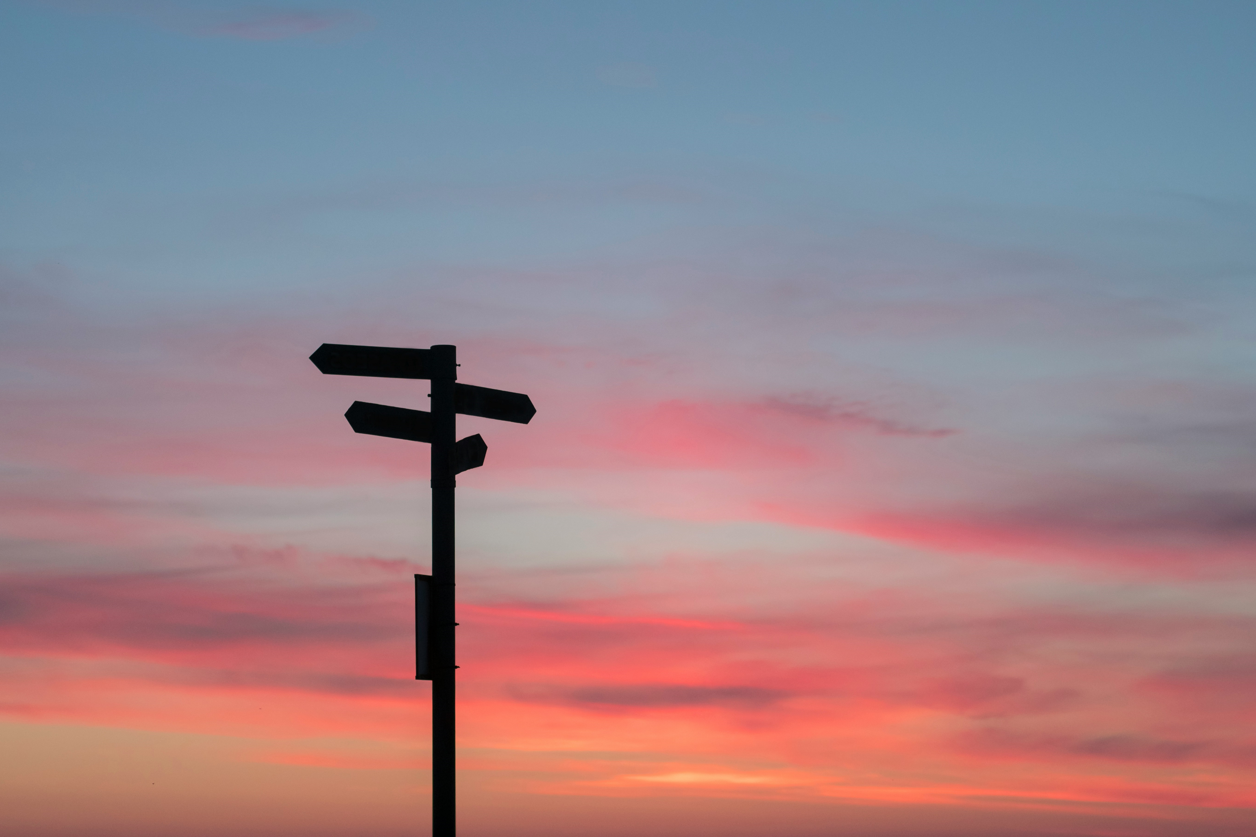
1.目標
Notes:
https://unsplash.com/photos/silhouette-of-road-signage-during-golden-hour-C7B-ExXpOIE

Slide 3
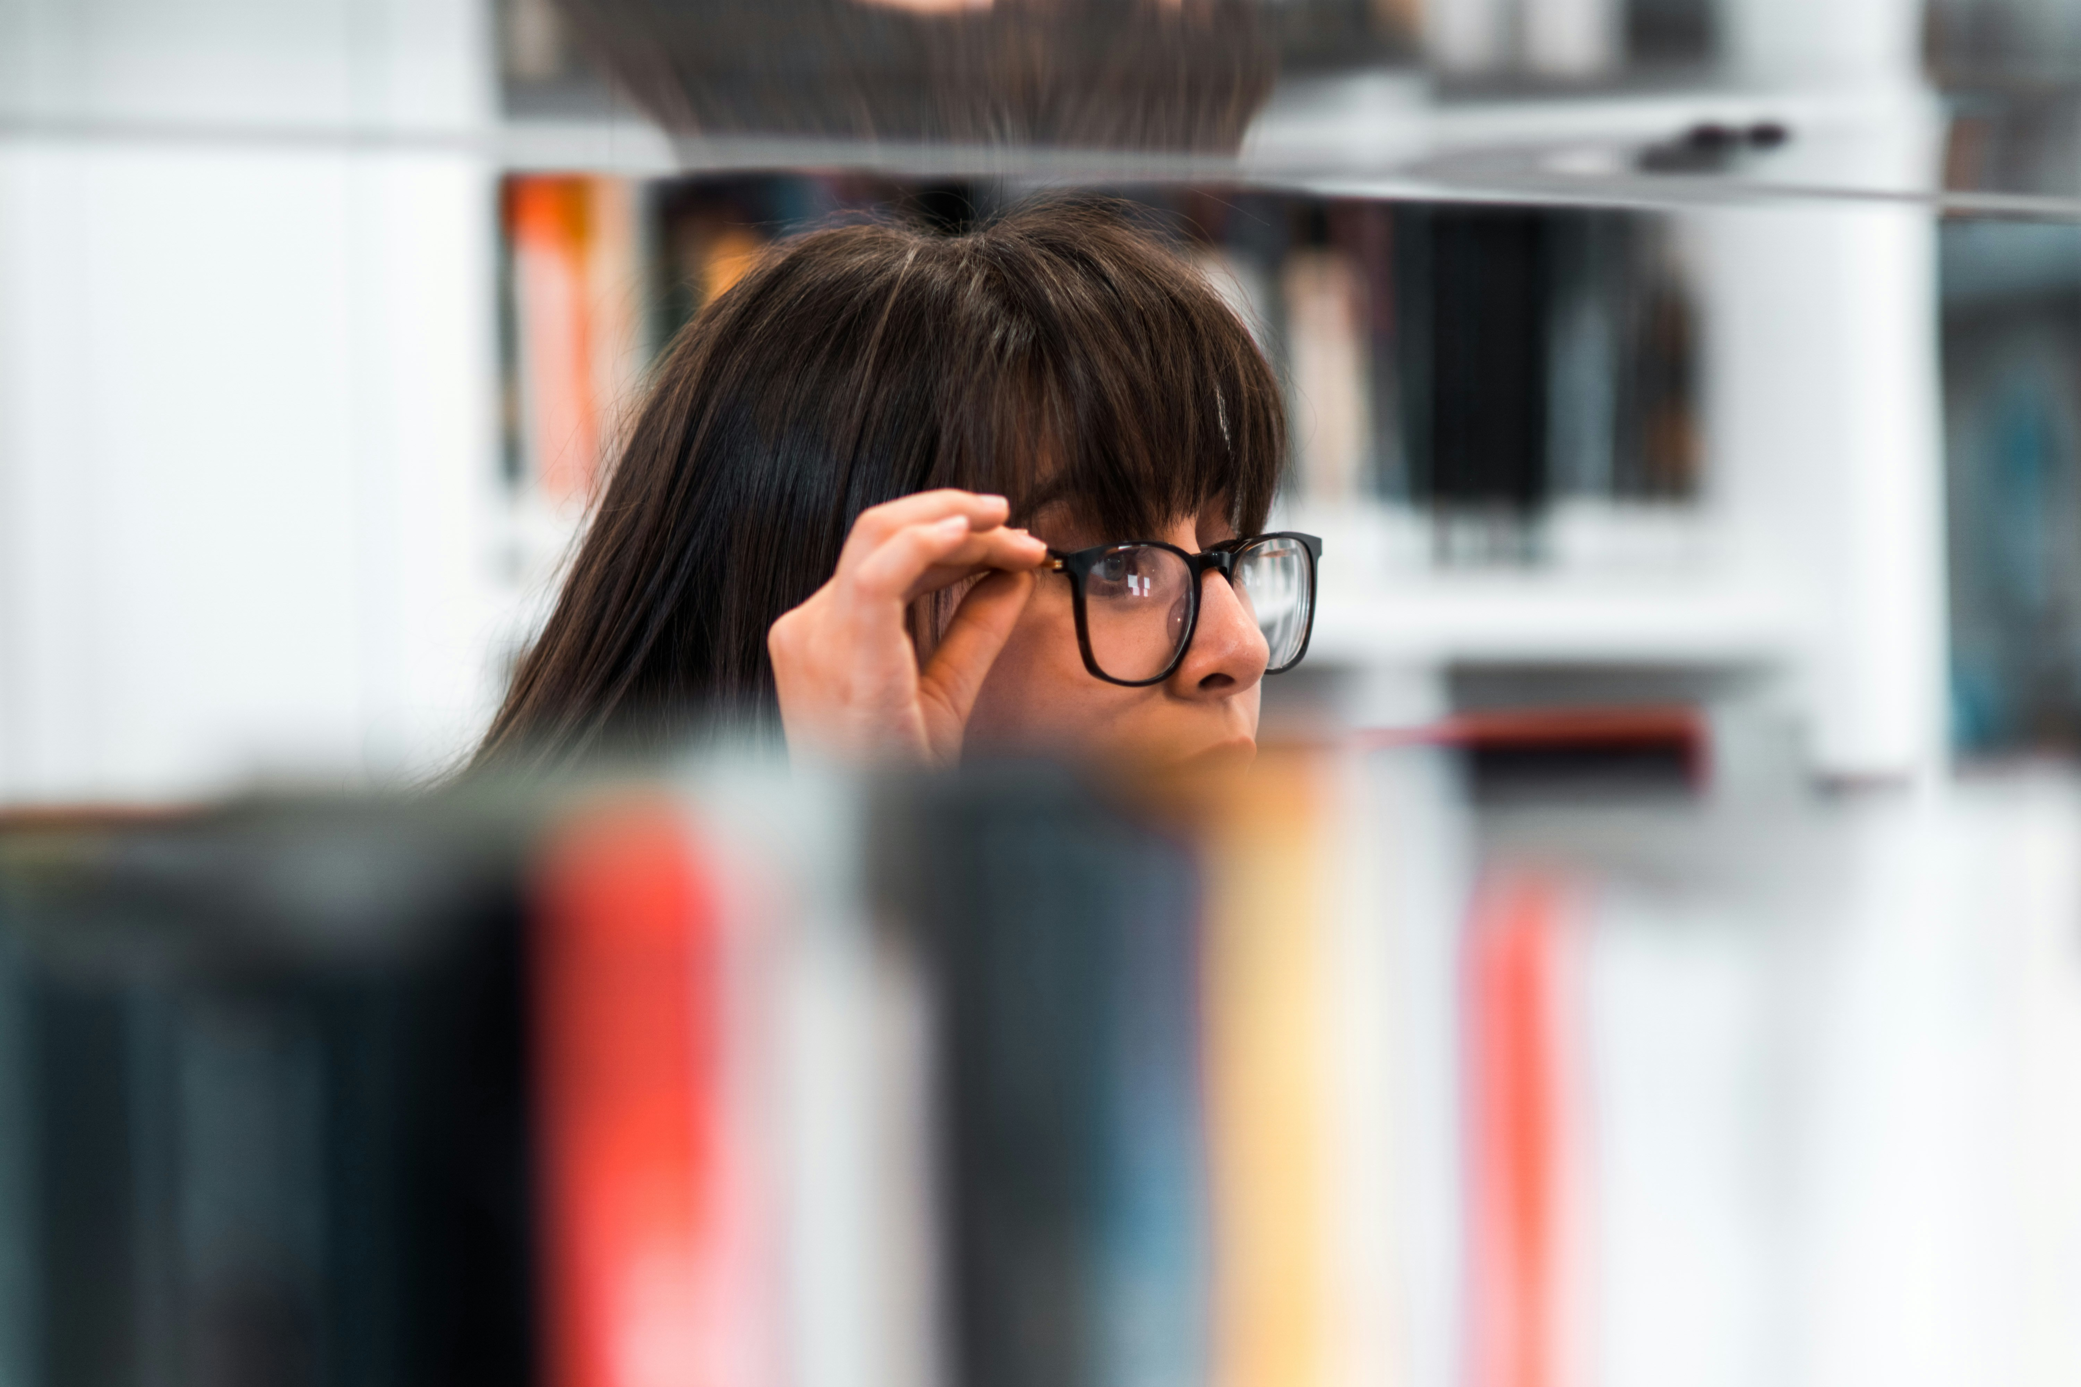
Notes:
https://unsplash.com/photos/woman-wearing-eyeglasses-eo6t2CSxXhc

Slide 4
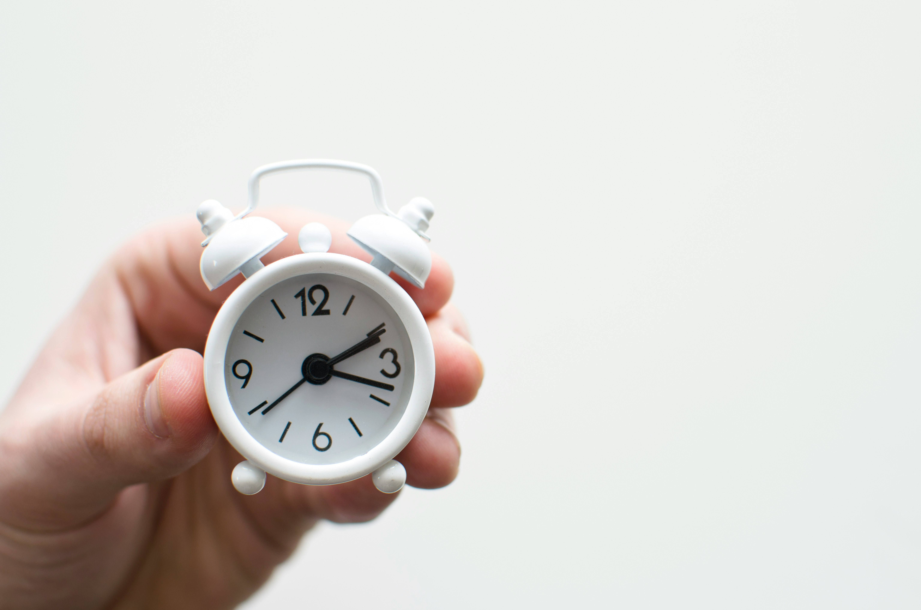
2.阻礙
Notes:
https://unsplash.com/photos/person-holding-white-mini-bell-alarmclock-UAvYasdkzq8

Slide 5
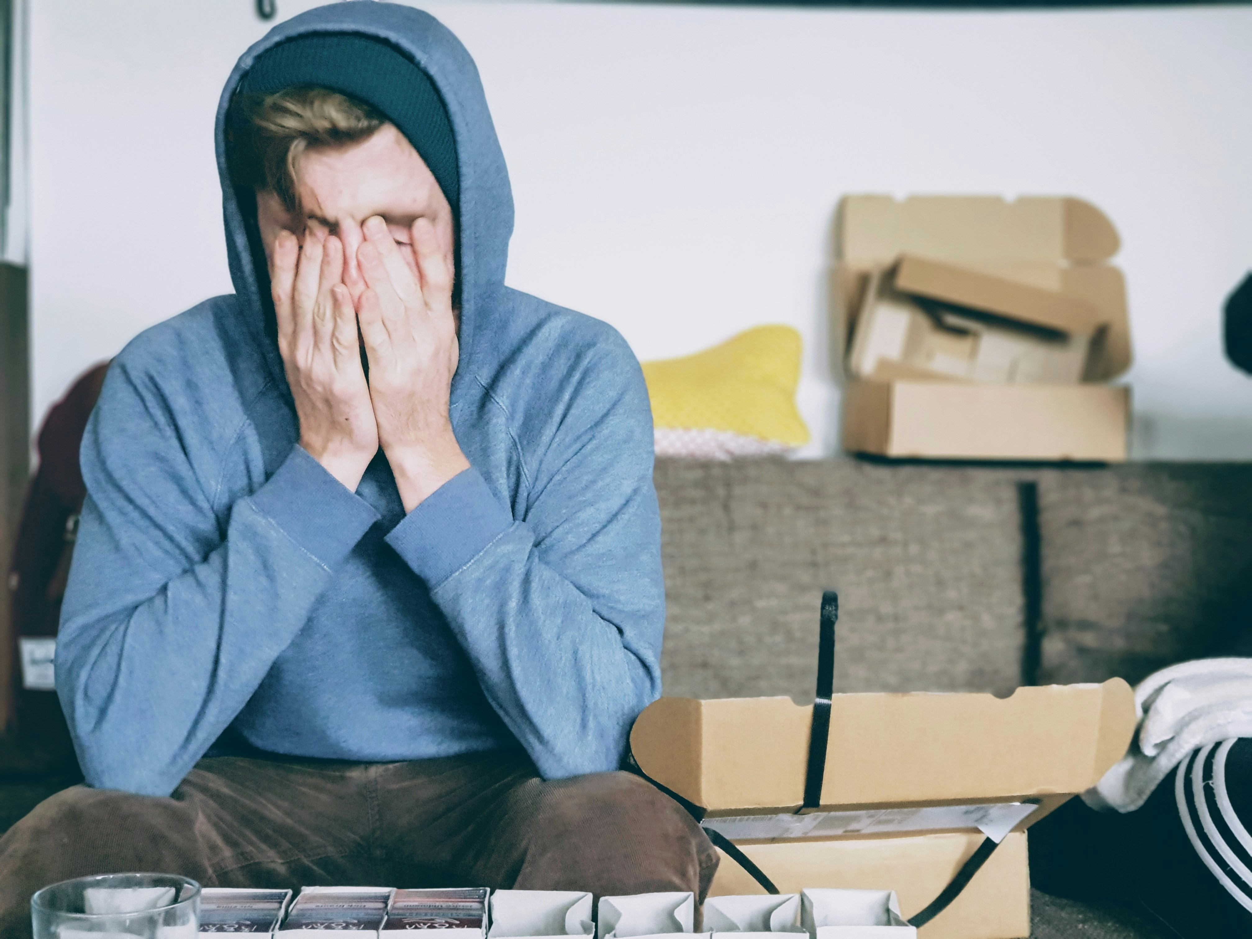
Notes:
https://unsplash.com/photos/man-covering-face-with-both-hands-while-sitting-on-bench-sxQz2VfoFBE

Slide 6
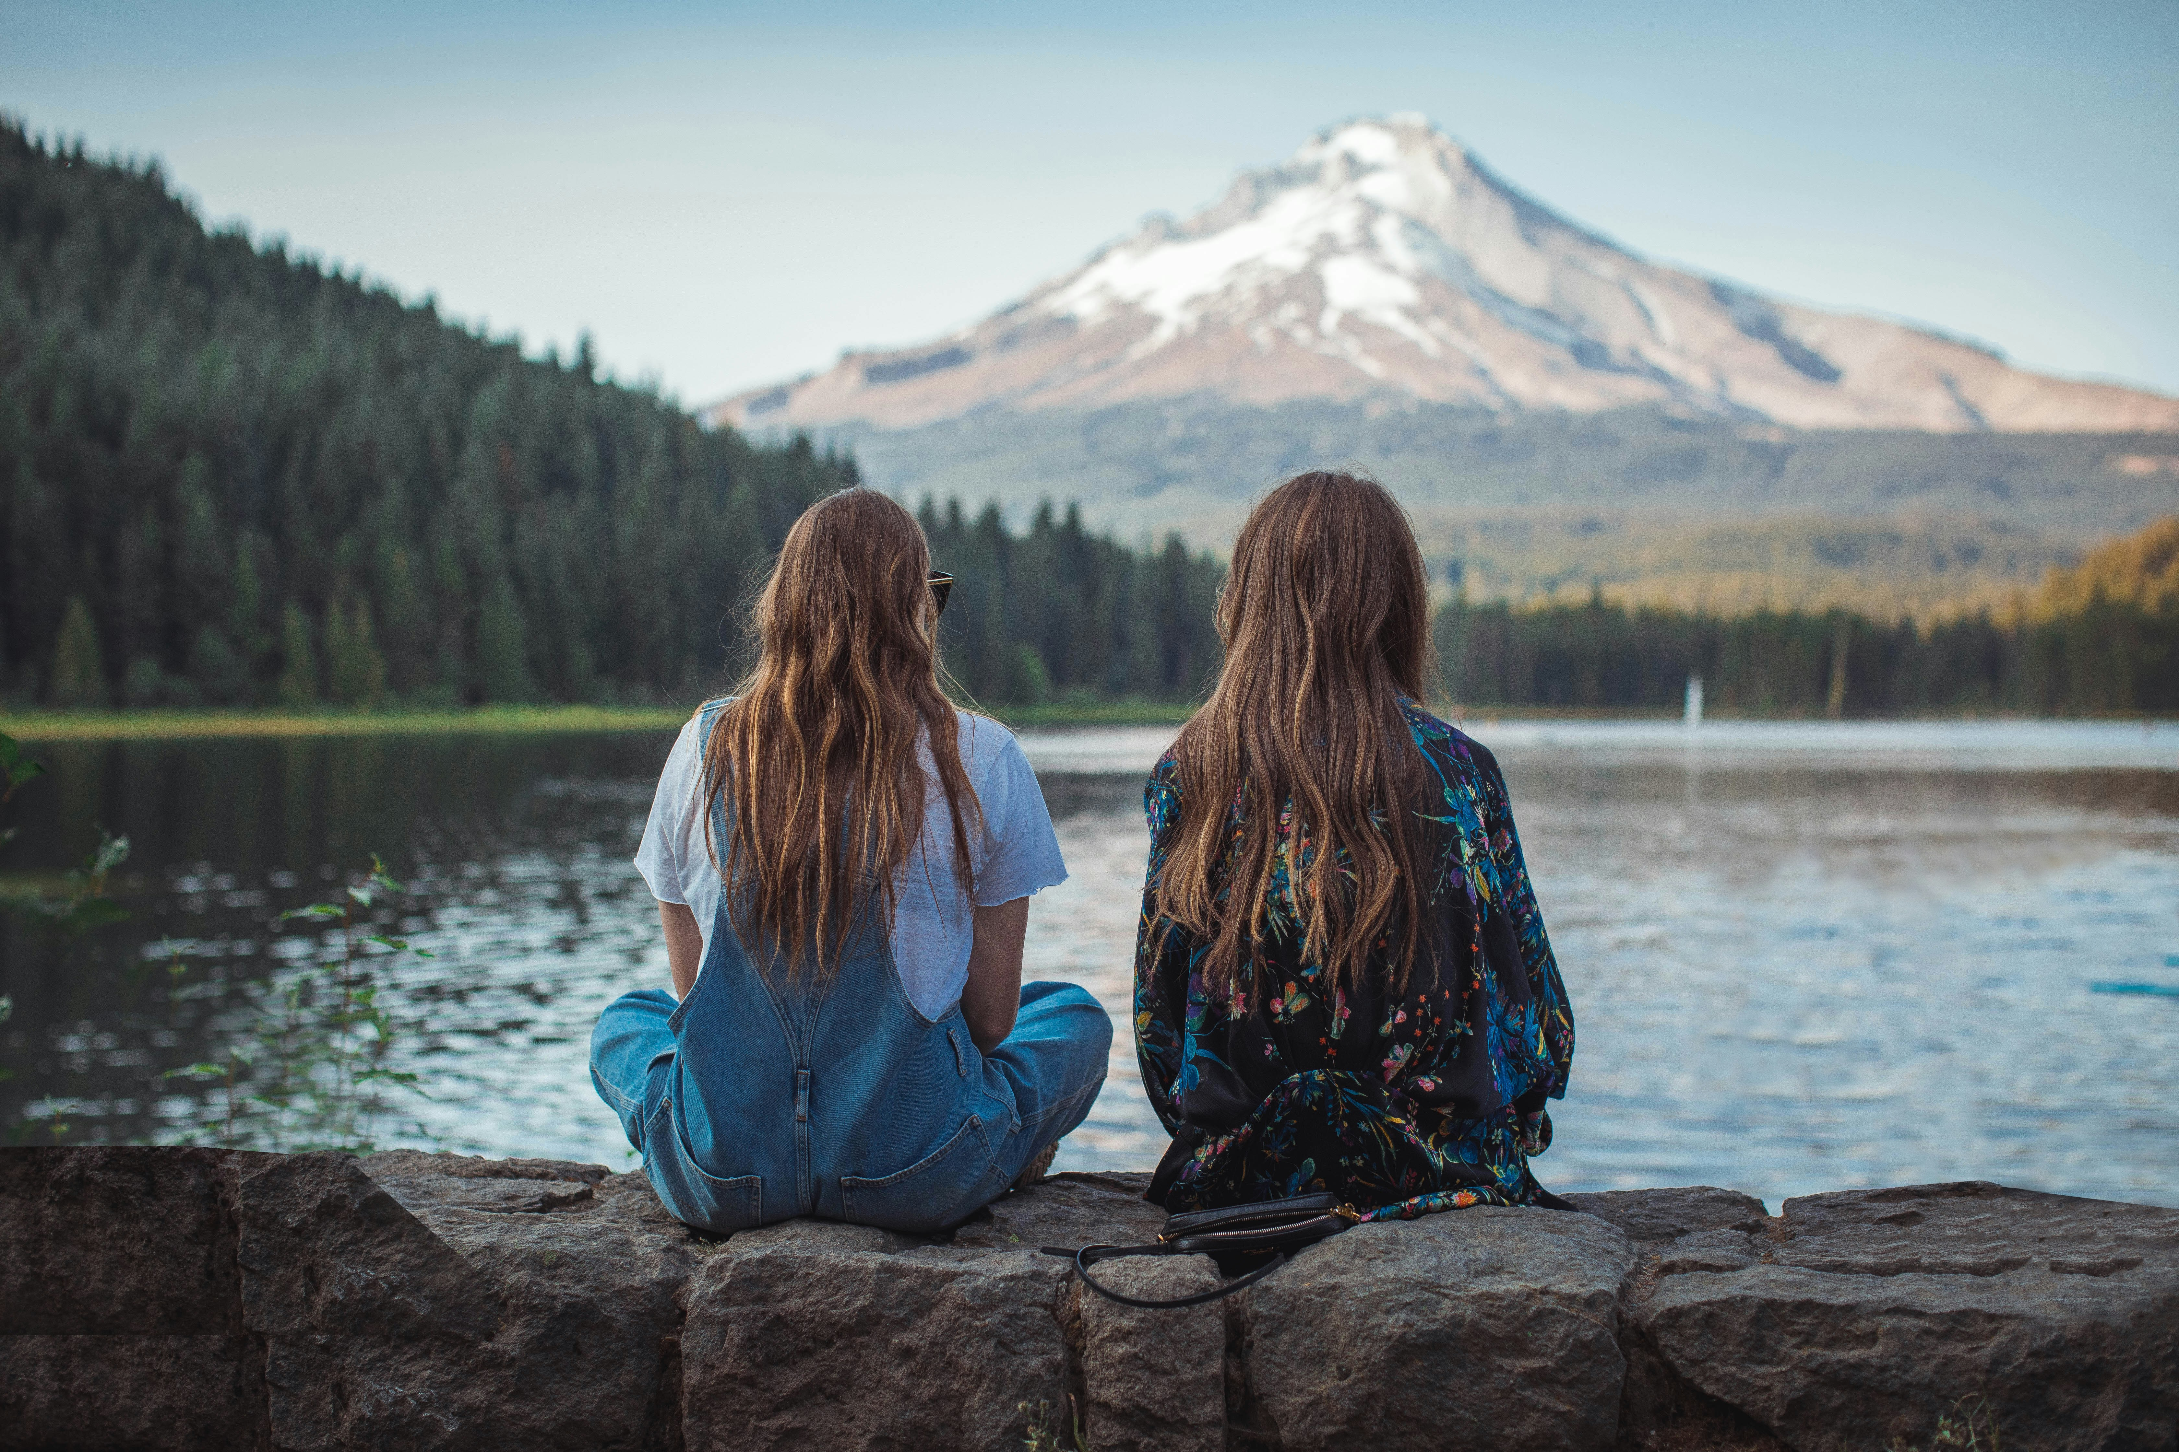
3.努力
Notes:
https://unsplash.com/photos/women-sitting-on-rock-near-body-of-water-vRAYwESFc-U

Slide 7
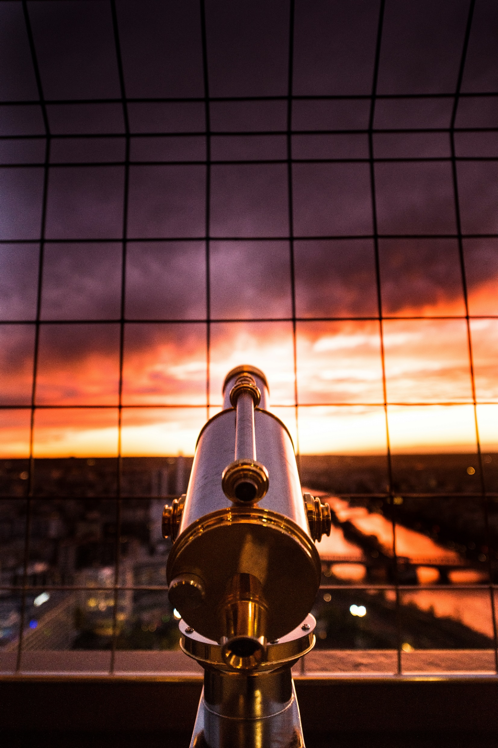
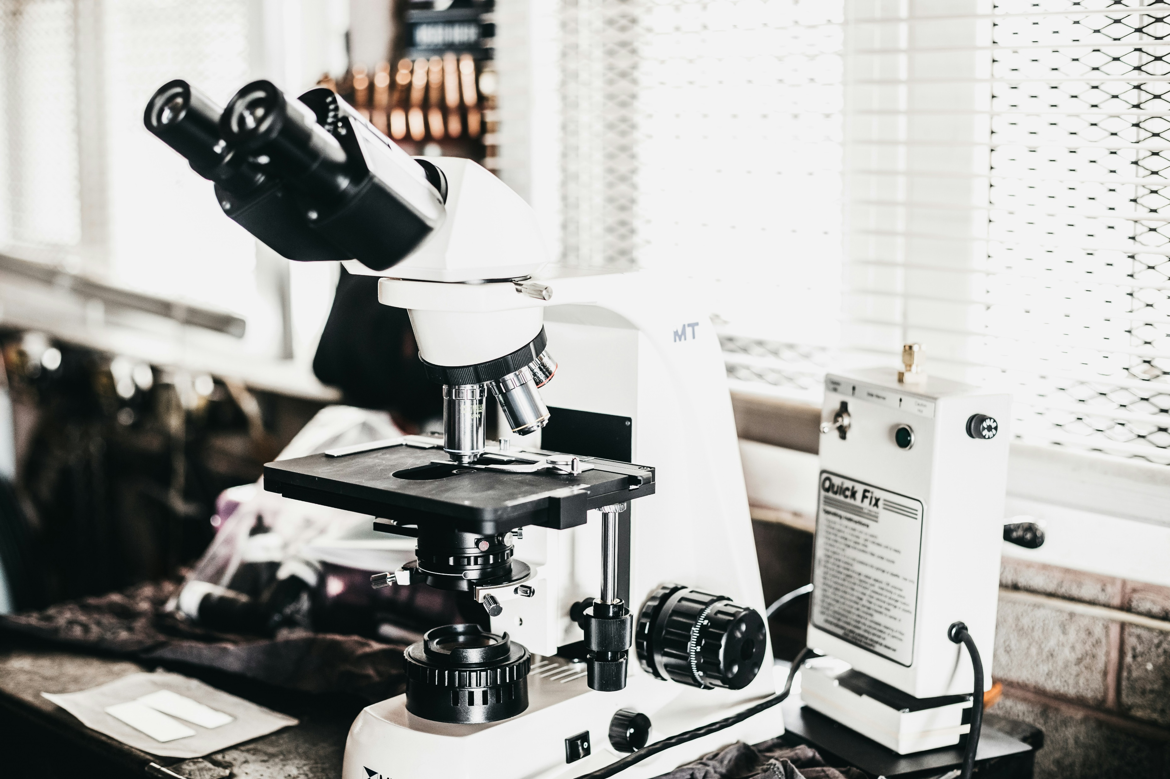
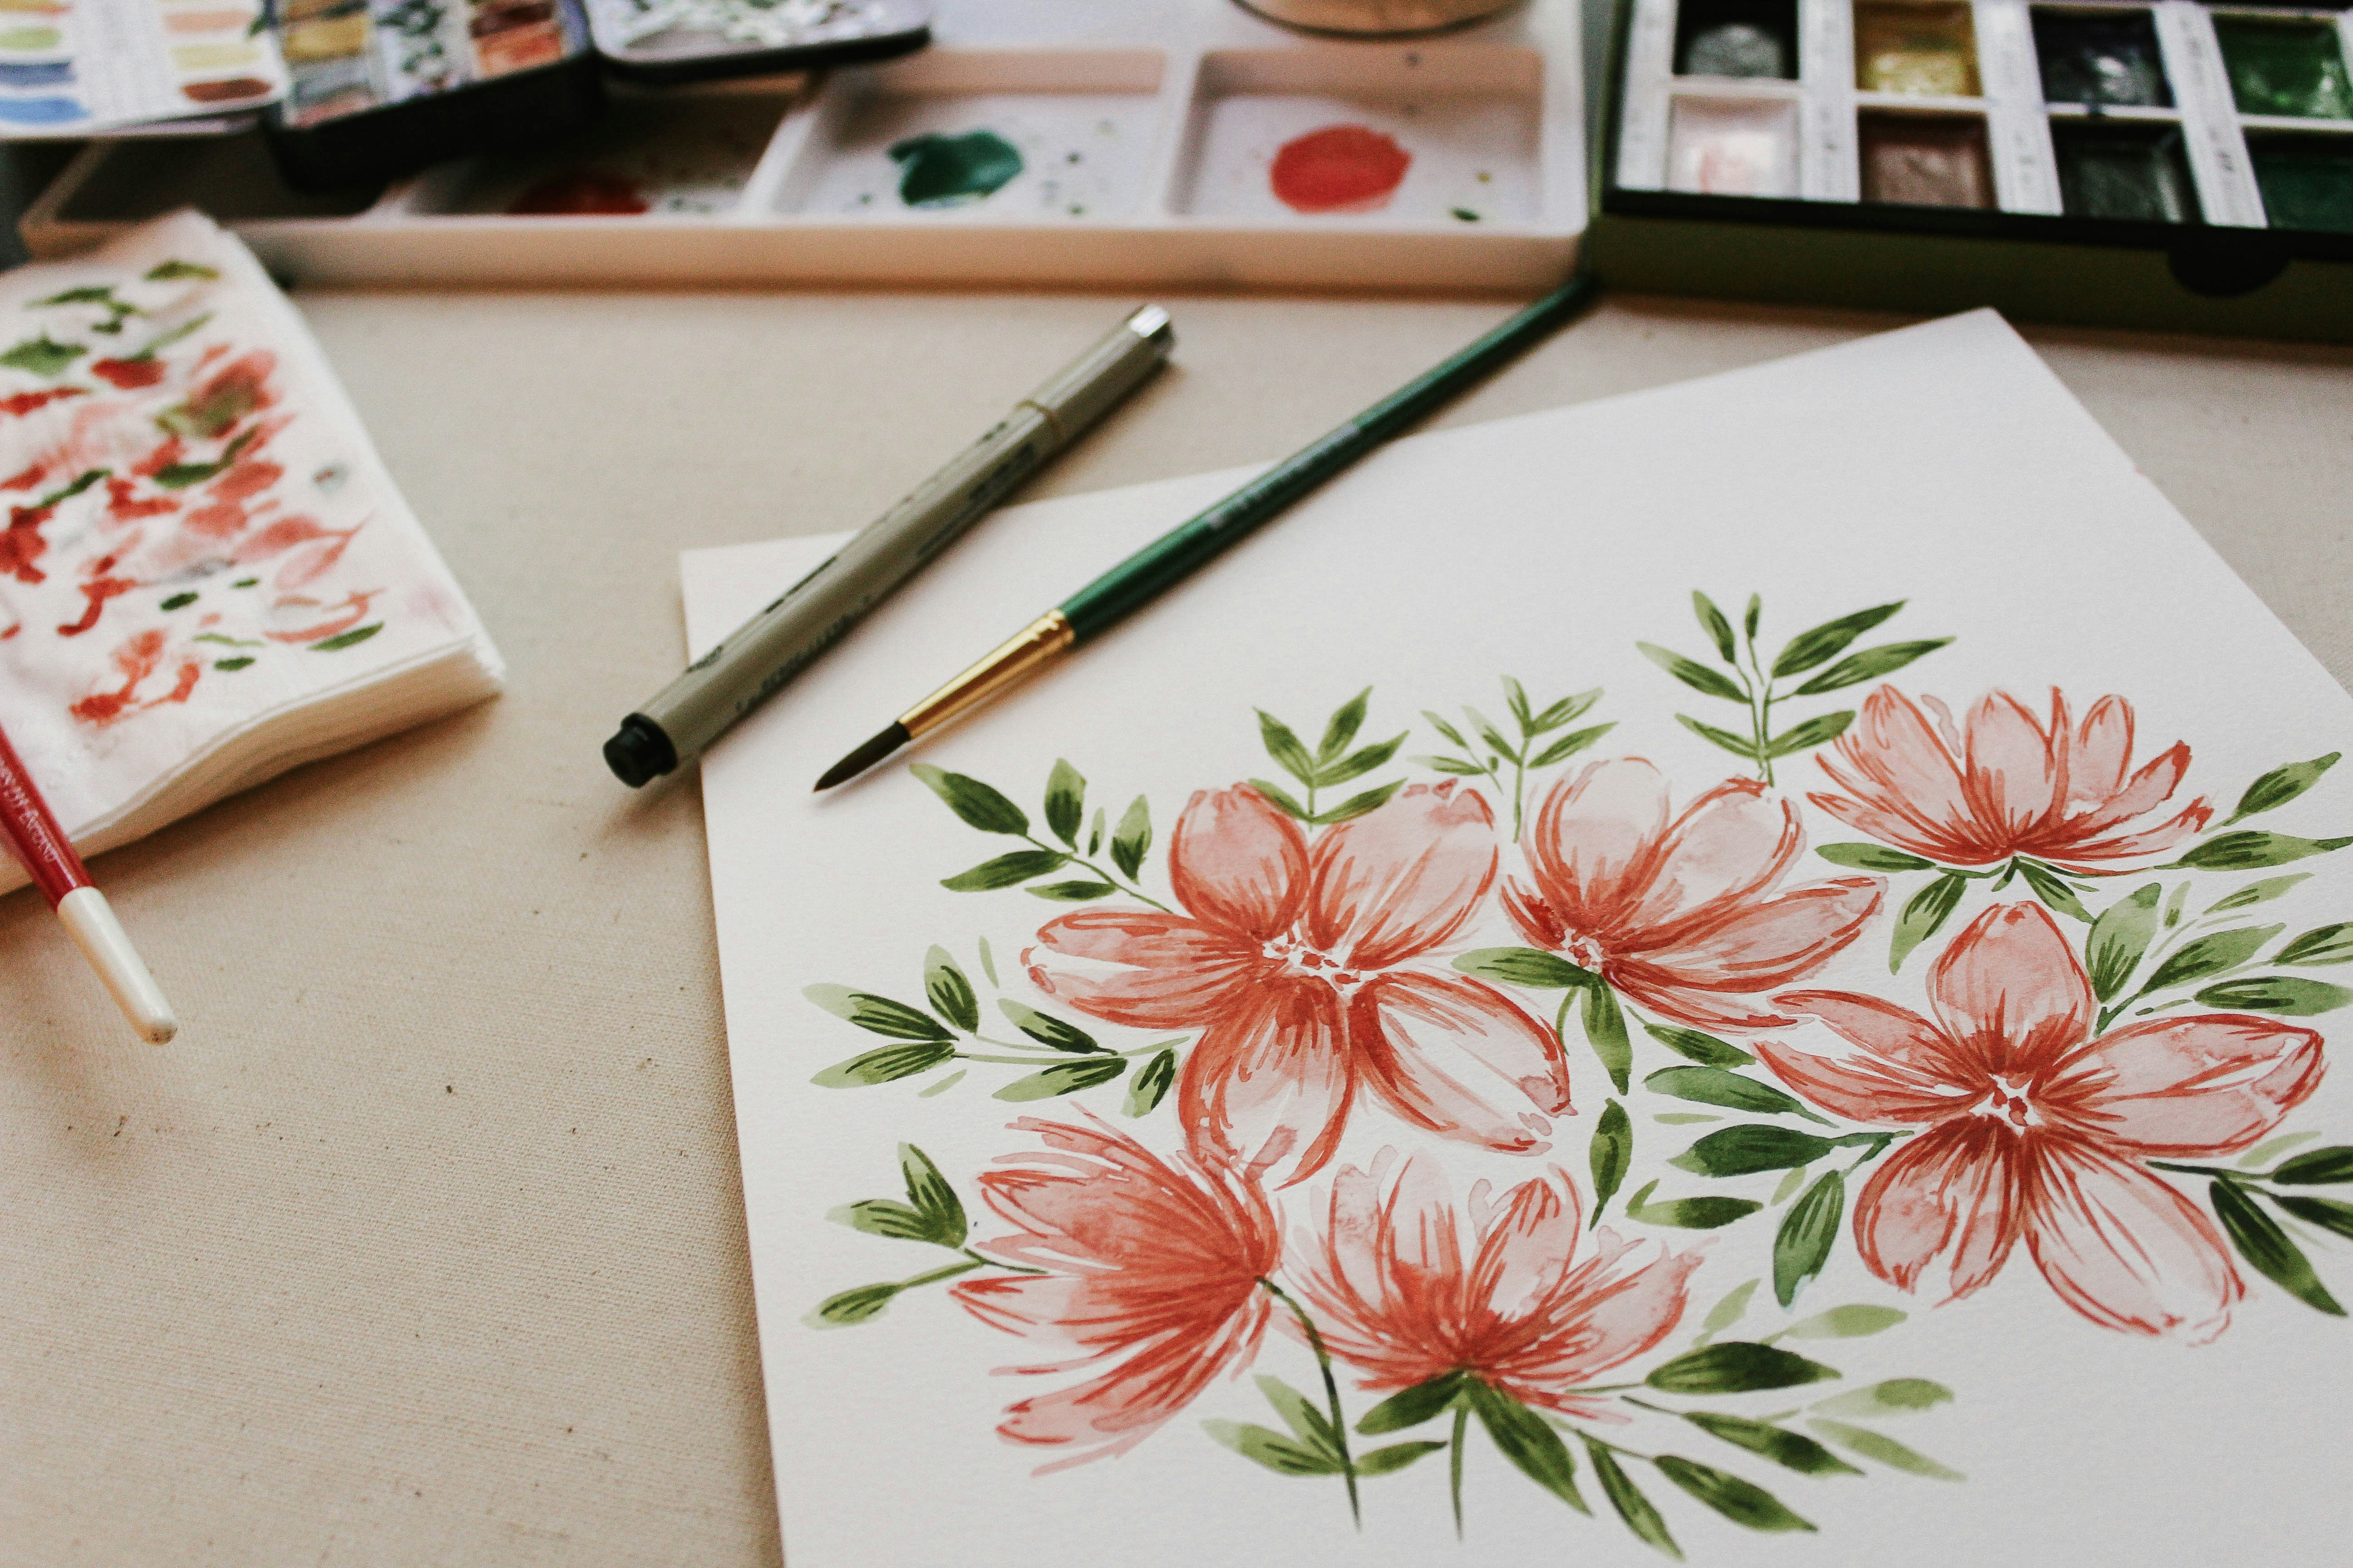
Notes:
https://unsplash.com/photos/black-and-silver-espresso-machine-BQ95Oc7Nvvc
https://unsplash.com/photos/red-petaled-flower-painting-U-ouhtPgHH4
https://unsplash.com/photos/gray-and-yellow-telescope-against-grill-4bY-VkQ0UZQ

Slide 8
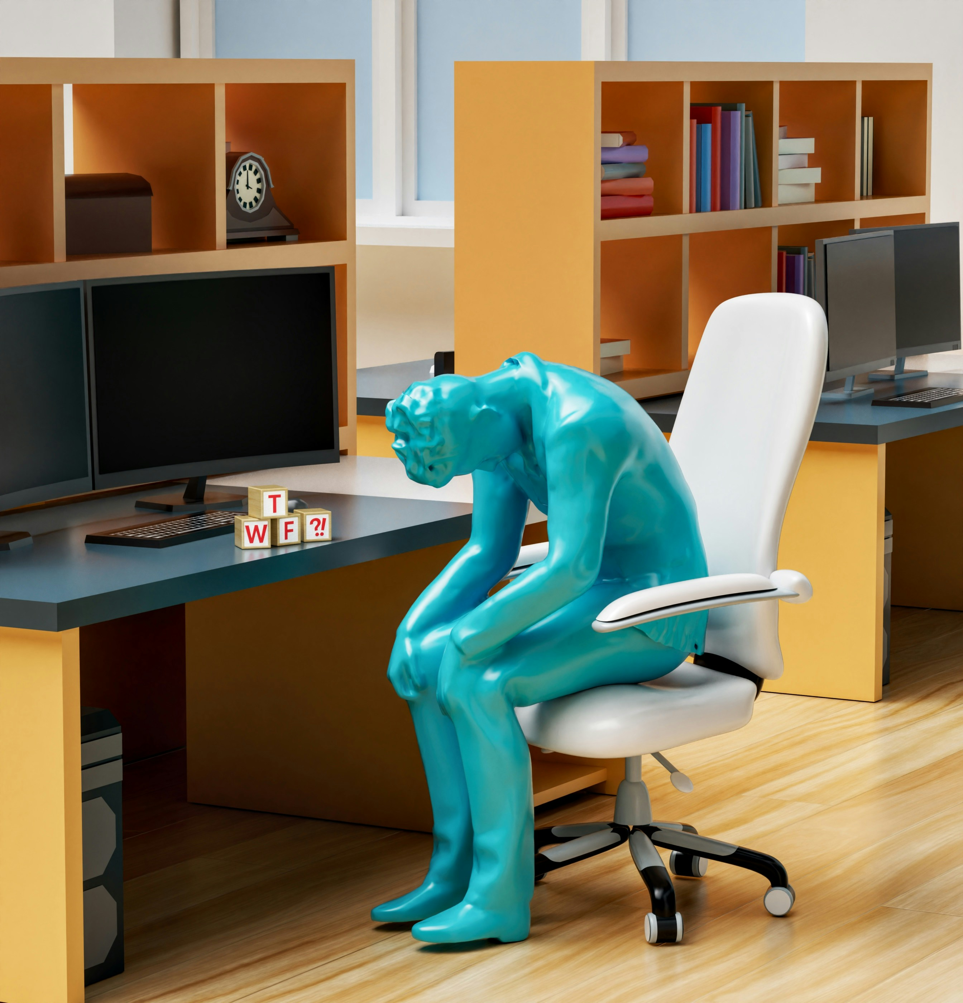
4.結果
Notes:
https://unsplash.com/photos/a-statue-of-a-person-sitting-on-a-chair-in-front-of-a-desk-63hYwd9J0X0

Slide 9
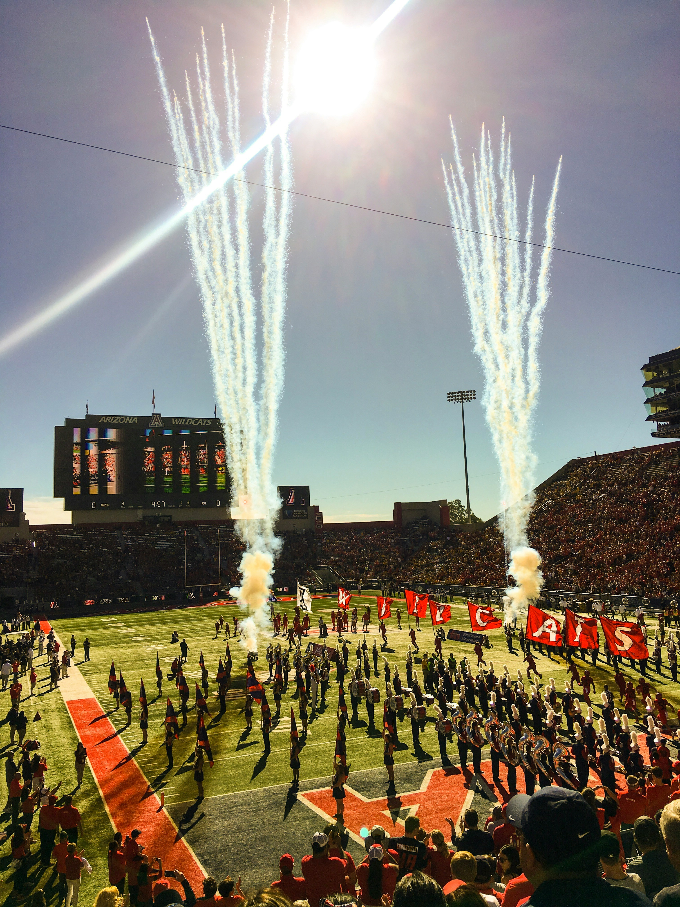
Notes:
https://unsplash.com/photos/people-standing-at-stadium-jI3PmZZscBs

Slide 10
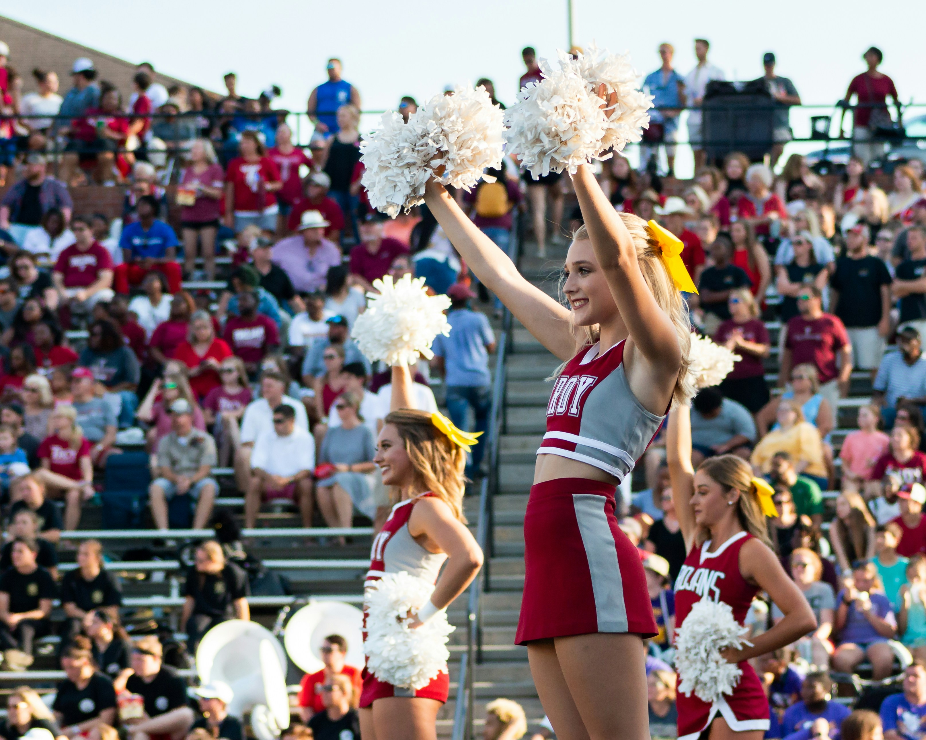
5.意外
Notes:
https://unsplash.com/photos/women-in-white-and-red-uniform-dancing-on-stage-during-daytime-dOOHkkT2q-E

Slide 11
Notes:
https://unsplash.com/photos/women-in-black-and-white-tank-top-tl6kEtP6nn8

Slide 12
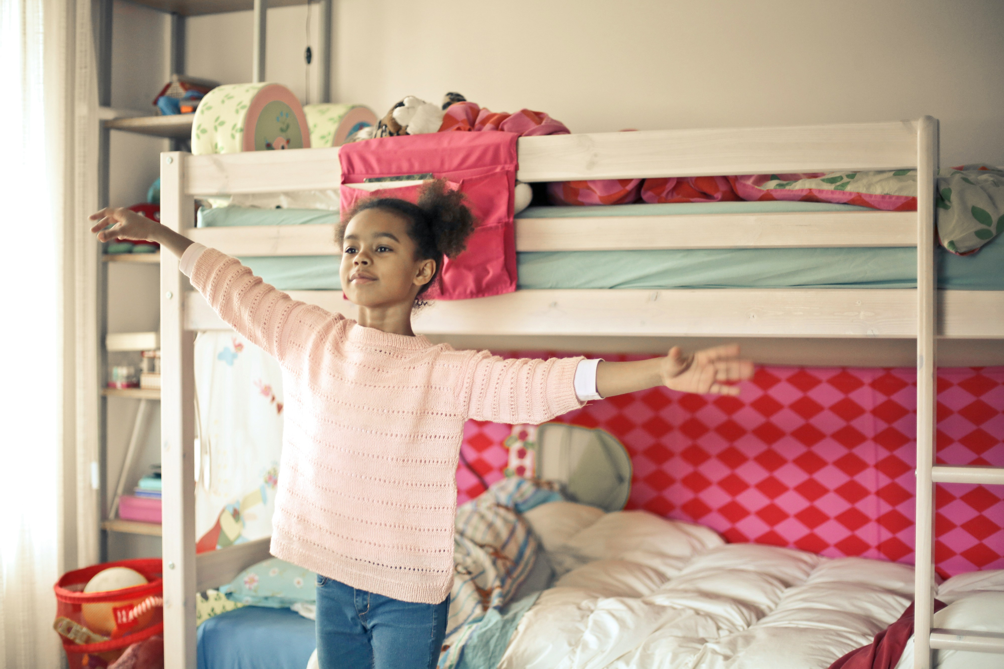
6.轉彎
Notes:
https://unsplash.com/photos/girl-in-white-and-red-long-sleeve-shirt-and-blue-denim-jeans-standing-near-bed-wj8jq4a_qLI

Slide 13
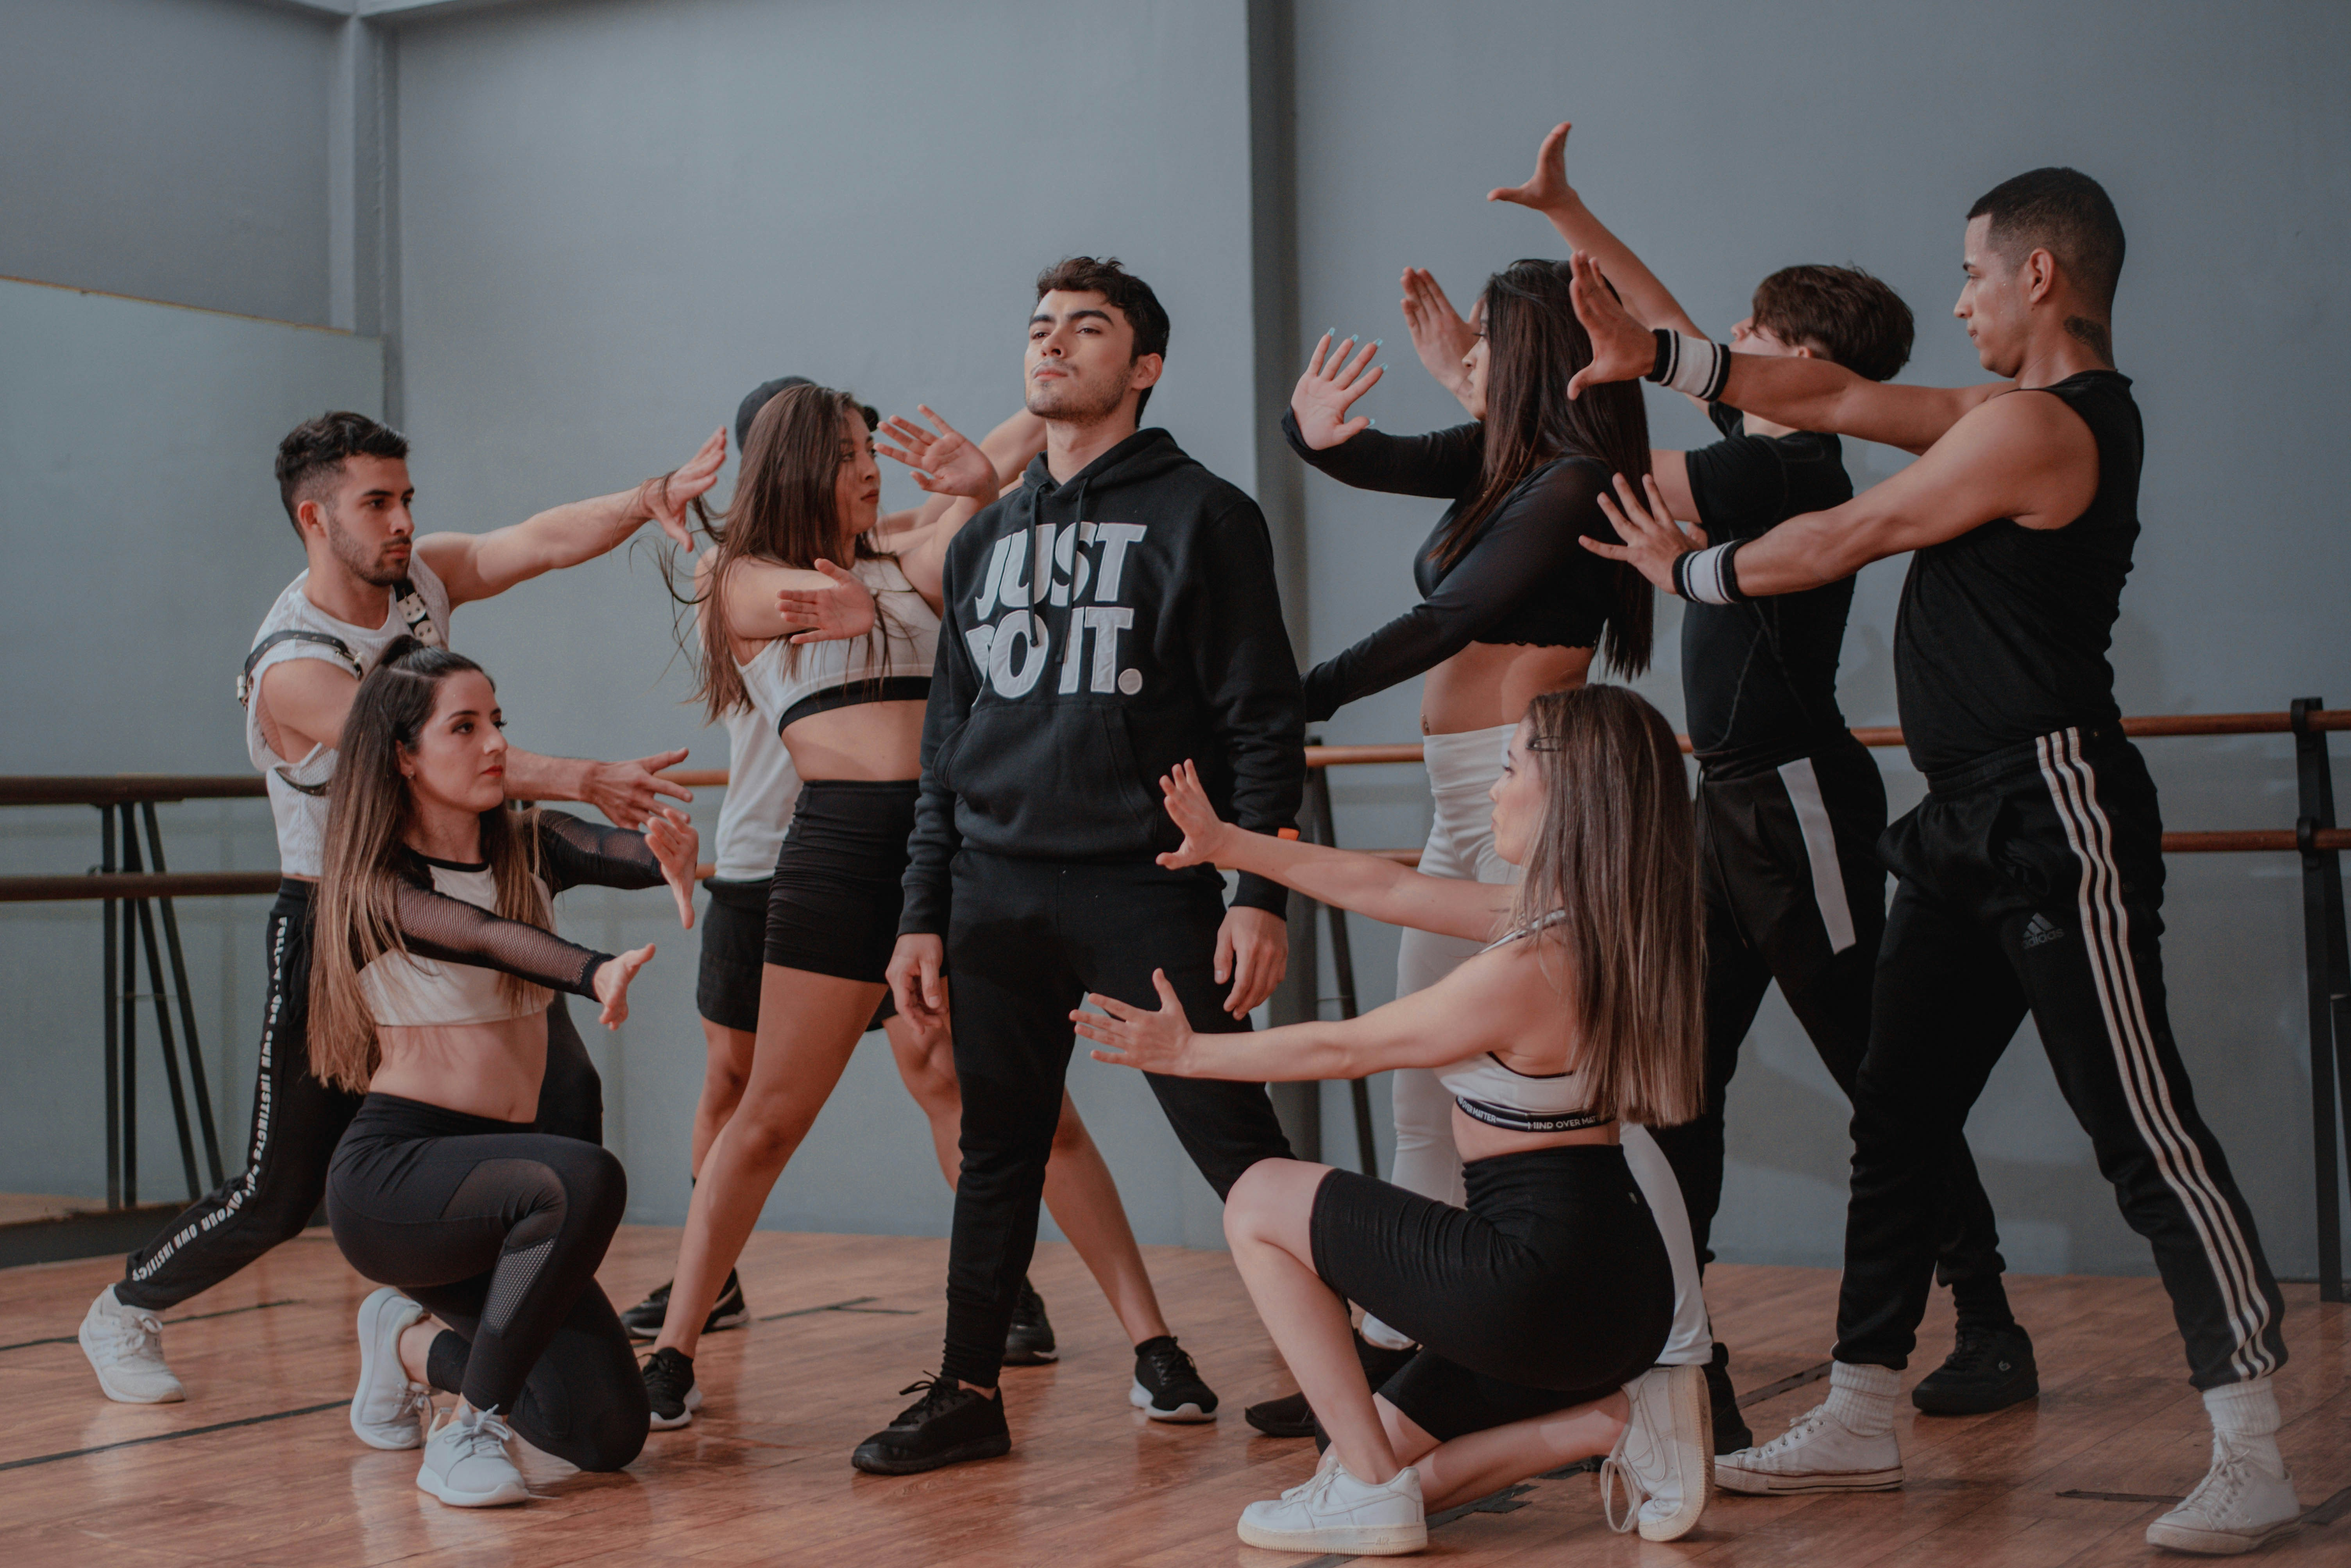
Notes:
https://unsplash.com/photos/group-of-women-in-black-and-white-crew-neck-t-shirts-Nwc-Z3_aEvw

Slide 14
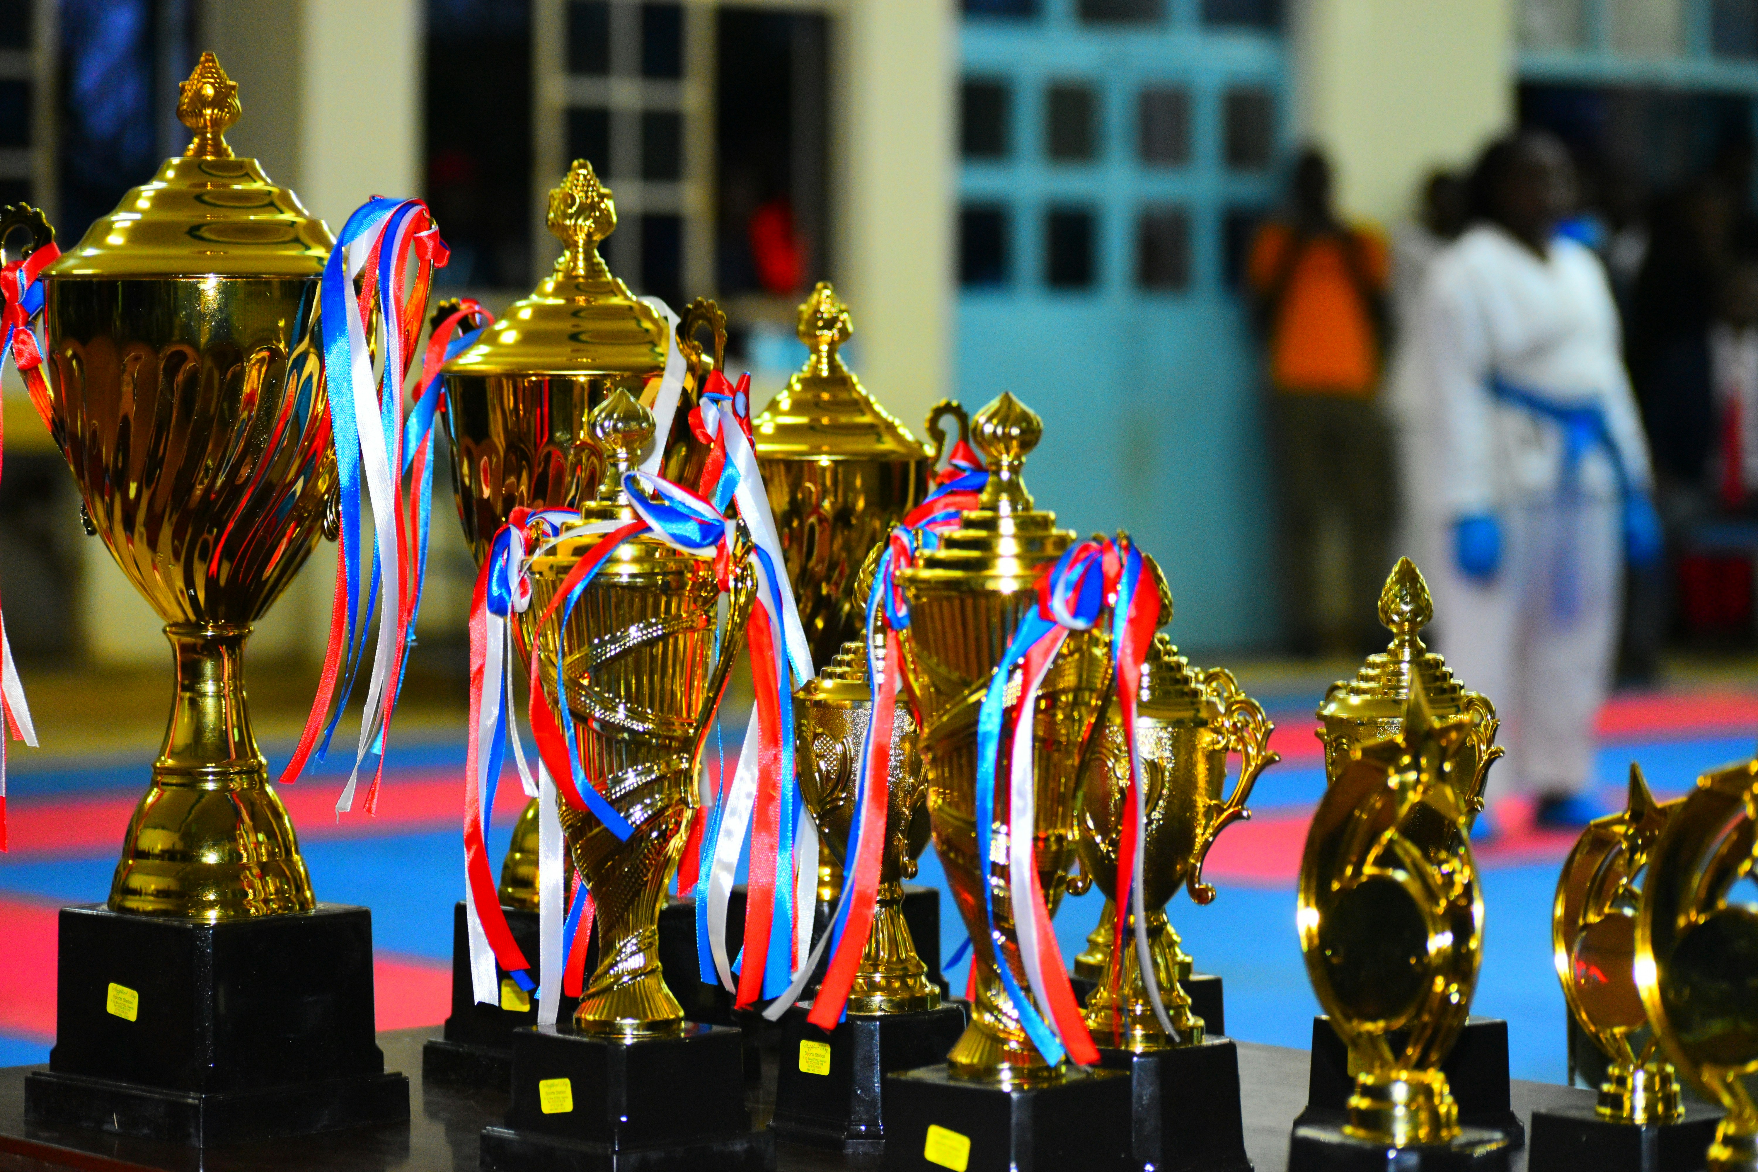
Notes:
https://unsplash.com/photos/a-group-of-vases-sit-on-a-table-jXqlkby9ylY

Slide 15

7.結局
Notes:
https://unsplash.com/photos/white-love-neon-light-signage-hJXjkEoHDSk

Slide 16
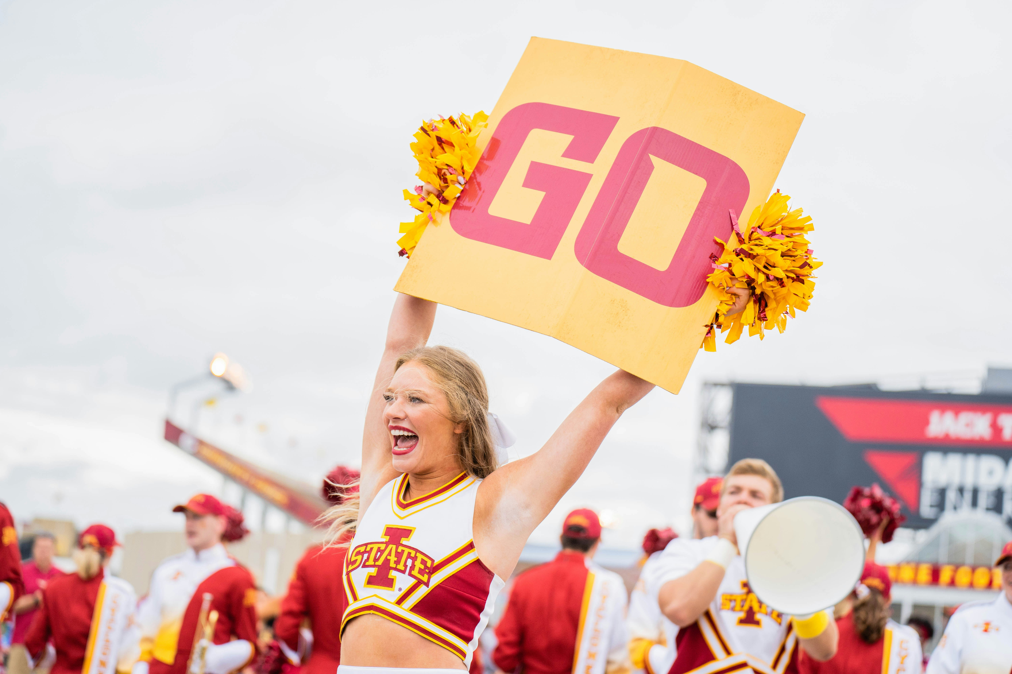
Notes:
https://unsplash.com/photos/a-cheerleader-holding-a-sign-in-the-air-RhSK0LRIUlw

